Slide 1



Introducing the
Fiver Challenge
Notes:
Teacher Notes
Introduction:
The PowerPoint presentation provides:
An introduction to the Fiver Challenge and how it will work across the 4 weeks.
An activity to encourage pupils to think about what it means to be an entrepreneur.
The opportunity to listen to other young entrepreneurs and learn from their experience.
Guiding you through the 4-week challenge:
We have also provided weekly slides corresponding with the 4 weeks of the Fiver Challenge.
Each of the further four presentations can be found on the Fiver Challenge platform within the relevant weekly section, and these contain the following:
A reminder of the tasks the pupils will need to think about and complete that week, together with a list of resources that will help them.
An activity that is linked to the tasks for that week to help them to succeed.
Note: Depending on how much time you have in advance of the challenge you may want to do some of the introductory activities earlier.

Slide 2
Young Enterprise
Young Enterprise is the UK’s leading financial and enterprise education charity and have been running programmes since 1963.
We run a range of enterprise and financial education programmes for young people aged 4 – 25.
Our Mission: Empowering young people to discover, develop and celebrate their skills and potential.
Our Vision: Every young person has the opportunity to learn the vital skills and enterprising mindset needed to earn and look after their money and make a positive contribution to their community.
Notes:
Teacher Notes
This presentation provides an overview of the Fiver Challenge. This is intended to excite the pupils about exploring their ideas and putting them into practice.
Note: Use the Fiver Challenge Word Guide throughout the presentations to provide pupils with explanations all of term used throughout the programme such as 'profit’.

Slide 3
What is an Entrepreneur?
An entrepreneur is a person who has an idea, and they set up a business to make their idea real and sell it to people.
If it’s a good idea, they can sell it for enough money to pay their costs and make a profit. They can use that profit for all sorts of things.
Notes:
Teacher Notes
Ask the pupils what kind of things/characteristics would make someone a good entrepreneur?
Use the next slide to summarise their ideas of what an entrepreneur is. Some ideas include: great communicator, problem-solver, risk-taker, open to learn, ambitious, creative, motivated
Note: Don’t forget to use the word guide throughout the presentations to provide pupils with explanations all of term used such as ‘cost’ and 'profit’.

Slide 4

What Skills Do Entrepreneurs Have?
These are our essential skills, and we can exhibit these in different ways.
During this challenge, we will look at improving the following skills:
Listening
Speaking
Problem Solving
Creativity
Aiming High
Teamwork
Notes:
Teacher Notes
Pupils will be developing their essential skills throughout this challenge, with a focus on Listening, Speaking, Problem Solving, Creativity, Aiming High and Teamwork.
These skills are important for education, work and wider life.
Name each skill so that they are aware and highlight their importance in life and as entrepreneurs.

Slide 5
What Skills Do Entrepreneurs Have?
Which skills do you think are most important for an entrepreneur?
Answer: All of these skills are important for an entrepreneur.
With your partner, pick a skill to chat about. What does this skill mean to you?
Notes:
Teacher Notes
Pupils will be developing their essential skills throughout this challenge, with a focus on Listening, Speaking, Problem Solving, Creativity, Aiming High and Teamwork.
These skills are important for education, work and wider life.
Name each skill so that they are aware and highlight their importance in life and as entrepreneurs.
Question- answer: All of the essential skills are important to be an entrepreneur, but sometimes we use some more than others.

Slide 6
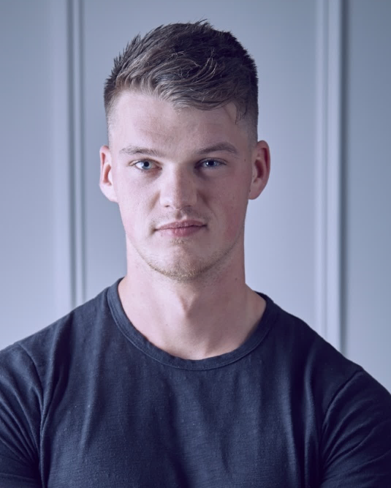
UK Entrepreneurs
One British example of someone who embodies the entrepreneurial characteristics is Ben Francis MBE – the owner of Gymshark. Having started the company as an exercise supplement business out of his parent’s garage with his friend, they branched out into clothing using a sewing machine and other equipment he bought using just £1,000 he had saved up. As a start-up, Ben marketed the company through partnerships with social media influencers, including YouTube body builders. Gymshark was one of the first brands to make extensive use of social media influencers.
At 32 he is now worth over £1 billion.

Slide 7

Notes:
Teacher Notes
Let’s hear some more advice and top tips from some young entrepreneurs that you will be able to use in your Fiver Challenge once you get started.

Slide 8
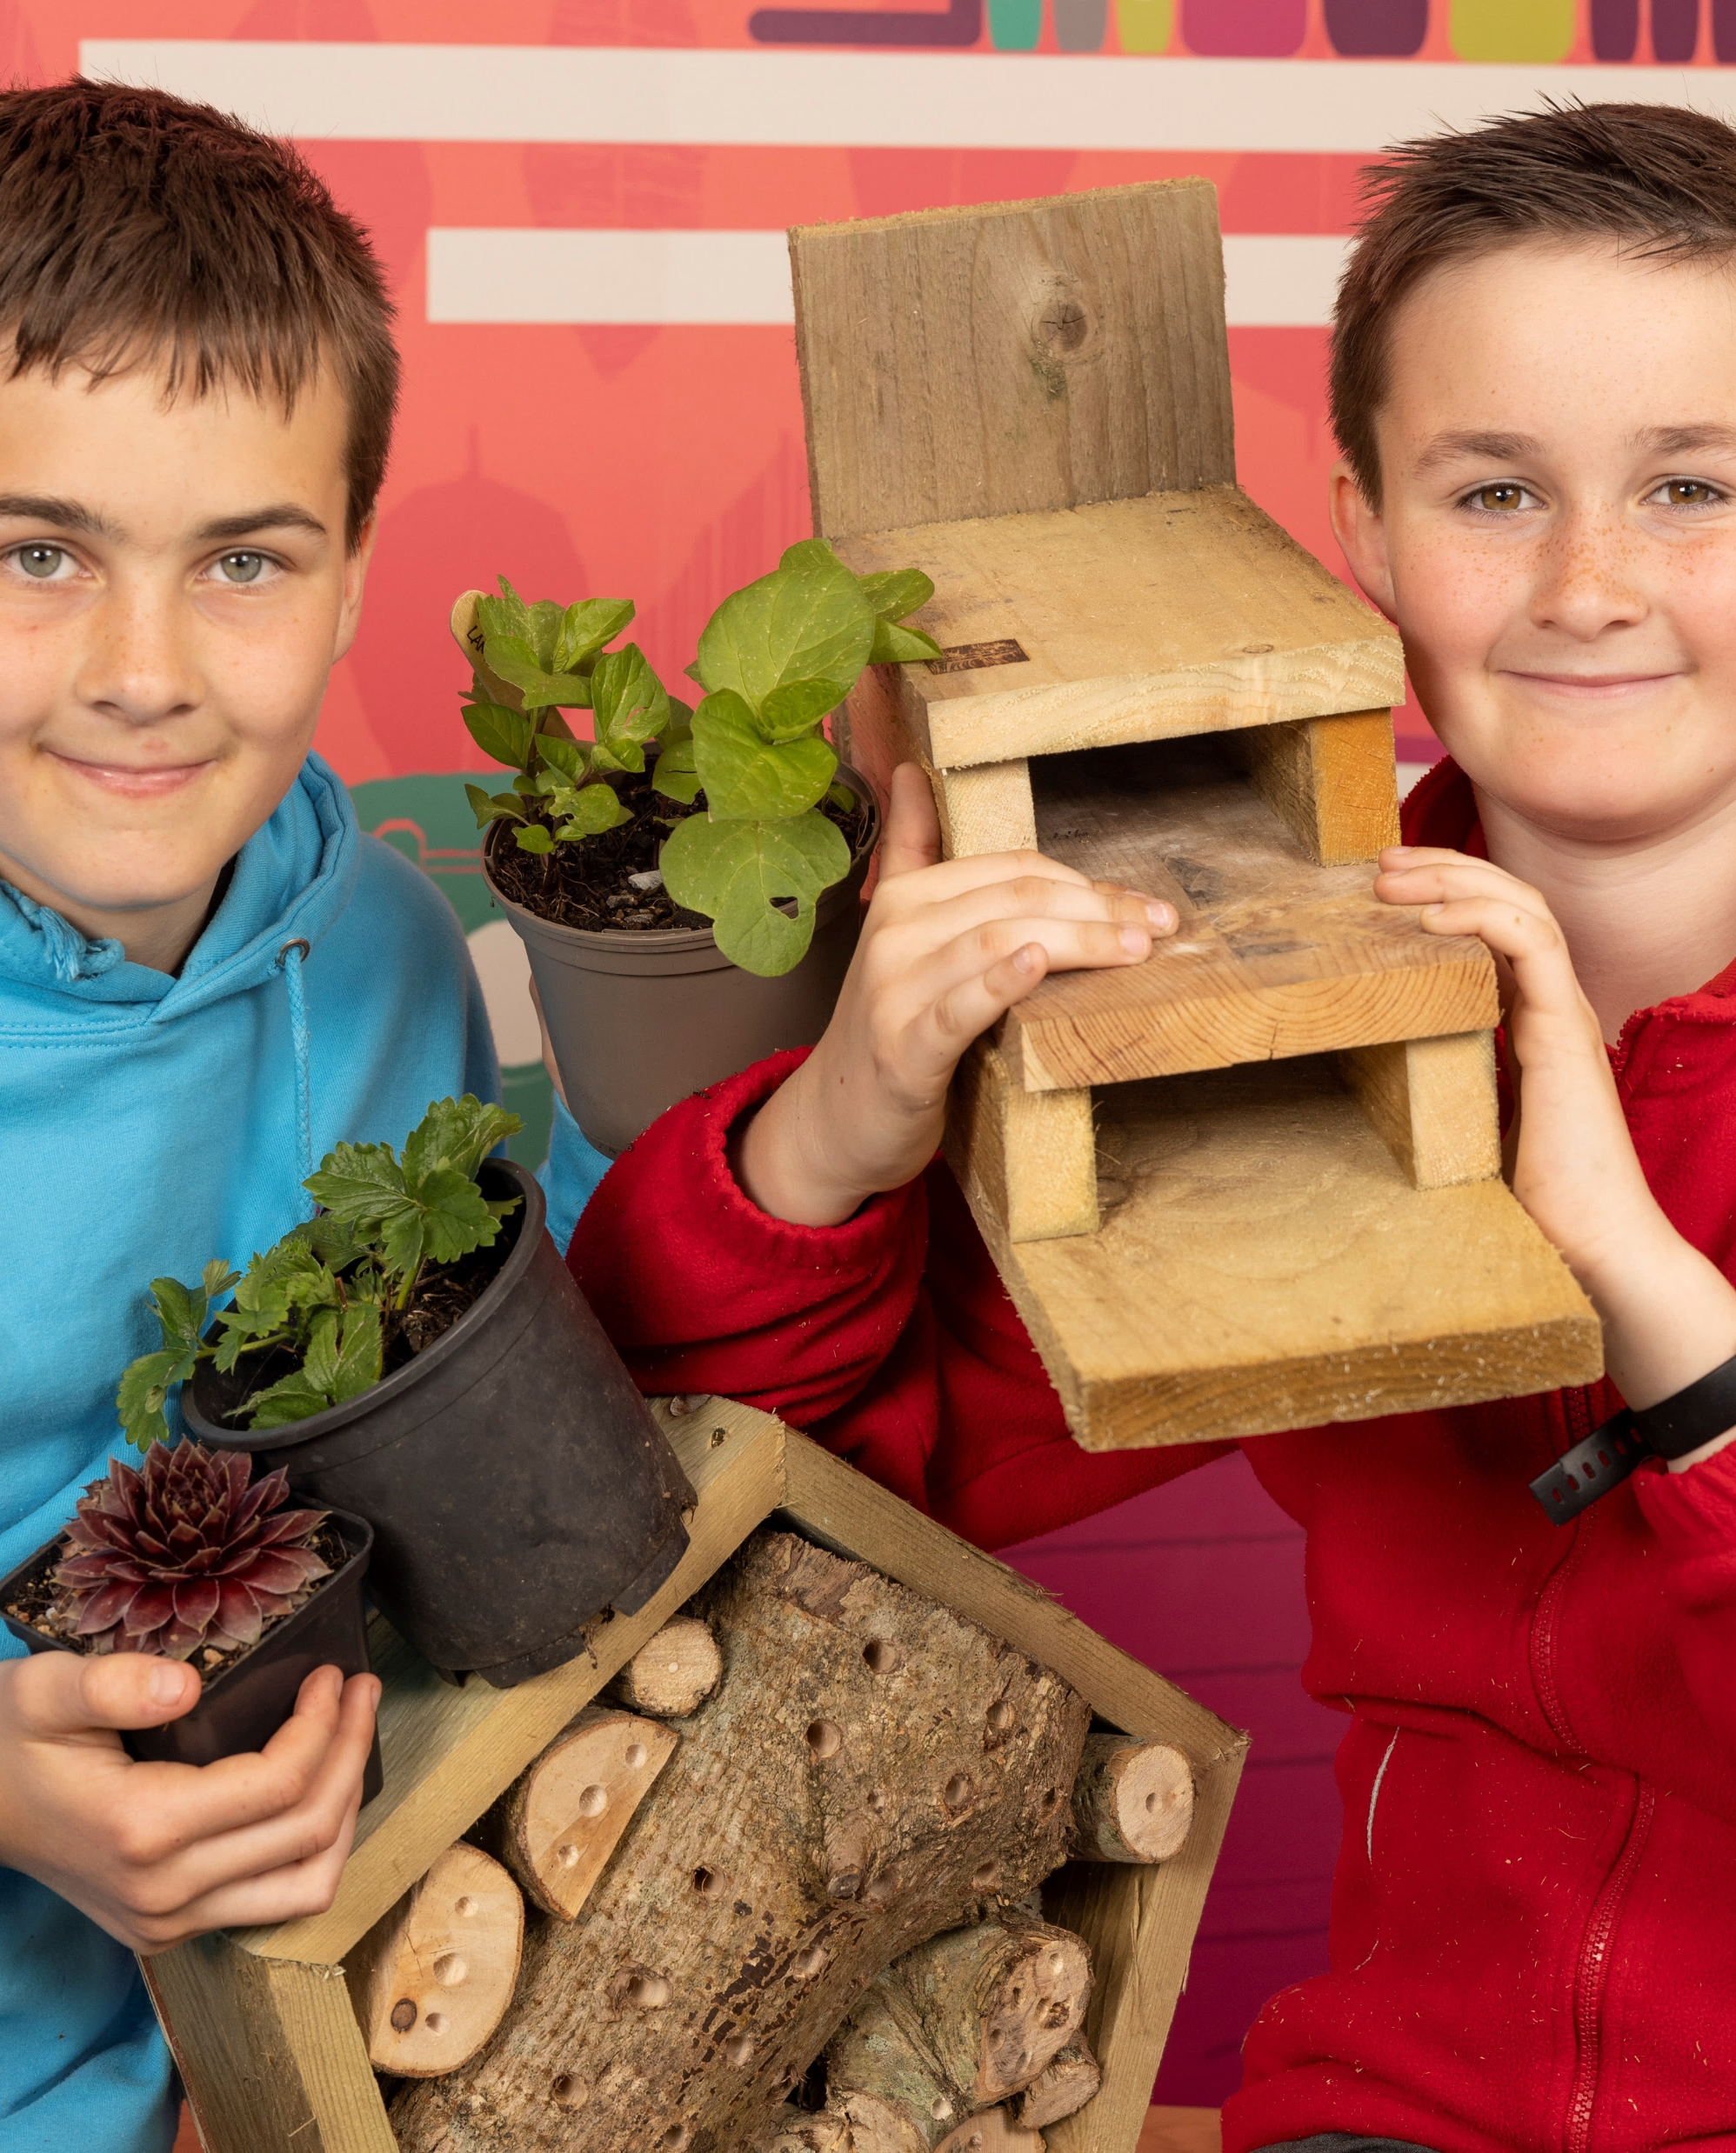
Young Entrepreneurs
Following the Fiver Challenge in 2021, Alex put his learning, experience and taste for entrepreneurship, alongside his brother Tomas, into his own family–run micro-business, Seeder Wood. The pair have continued growing and selling plants and have also expanded into woodwork, making a range of innovative garden items from bird tables to duck houses from scratch. Alex and Tomas have a great passion for sourcing scraps of wood and turning them into something that can be used and enjoyed for years to come.

Slide 9
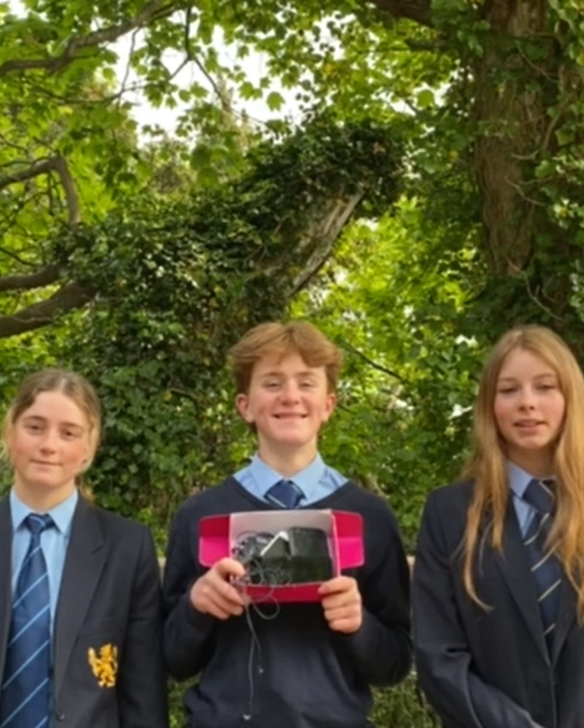
Young Entrepreneurs
A team from St. David’s College in Llandudno created Re-use I.T. in response to the problem of e-waste.
They partnered with companies to support the process of recycling, repairing, and re-using old and broken devices, such as laptops and mobile phones.
Re-use I.T. won the 2022 10X ‘Business for Good’ award for their contribution to the community, including donations of refurbished equipment to a local dementia-specialist care home.

Slide 10

So…What Is It?
With just a £5 initial investment and 4 weeks, teams must create, market, organise and financially manage their own business with the intention of making a profit.
Pupils can choose to work in a team of up to 8, or by themselves.
There are two weekly competitions and one national competition to enter.
At the end of the challenge, you pay back your £5 plus a 50p legacy contribution from teams who have made a profit.

Slide 11
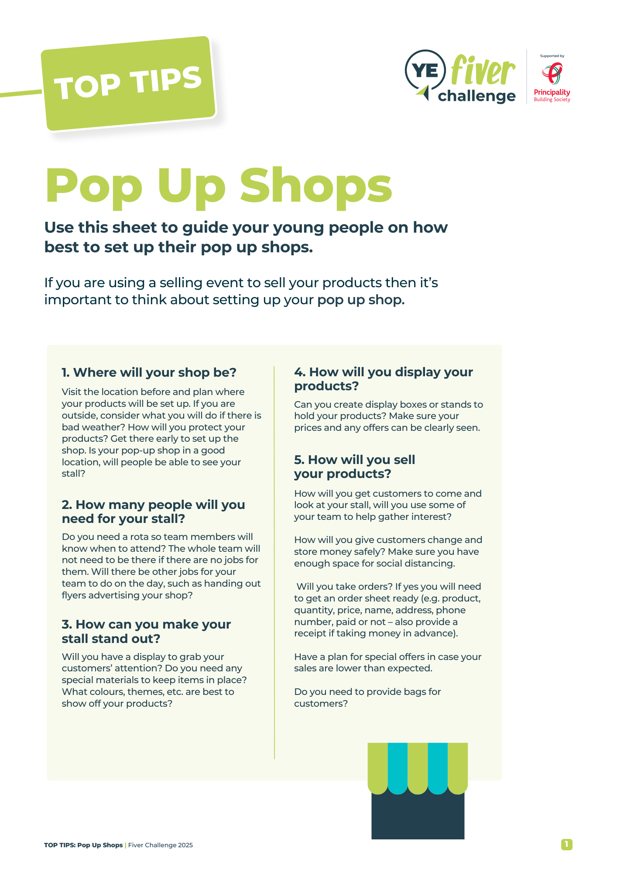
So…What Is It?
Profits are yours to keep and it’s up to you to decide how to spend it.
Supporting materials are accessible by your teacher via the Fiver Challenge digital platform to help you.

Slide 12



Week 1
Here’s £5!
Teams decide on a product or service in which to invest their £5, create a logo and enter the Logo Competition!
Logo Competition

Slide 13


Week 2
Getting Going
Teams source materials or products, prepare sales posters, and begin to plan their selling events.

Slide 14


Week 3
Keep It Going!
Teams get their product or service ready, promote their selling events, and enter the Sales Poster Competition!
Sales Poster Competition

Slide 15


Week 4
Profits & Pledge
Teams enter the National Competition and decide how to spend or donate their profit after repaying the initial £5 pledge, plus 50p legacy contribution to support the Fiver bank.
National Competition

Slide 16
Week 1
Here’s £5!
Teams decide on a product or service in which to invest their £5, create a logo and enter the Logo Competition!
Week 2
Getting Going
Teams source materials or products, prepare sales posters, and begin to plan their selling events.
Week 3
Keep It Going!
Teams get their product or service ready, promote their selling events, and enter the Sales Poster Competition!
Week 4
Profits & Pledge
Teams enter the National Competition and decide how to spend or donate their profit after repaying the initial £5 pledge, plus 50p legacy contribution to support the Fiver bank.
Logo Competition
Sales Poster Competition
National Competition

Slide 17
Competitions!
Weekly Competitions
Logo Competition (Week 1)
Sales Poster Competition (Week 3)
Weekly Competition Prizes
Winner receives a £100 voucher, plus £200 for their school or organisation.
Runner up receives a £50 voucher, plus £100 for their school or organisation.
Both entries will feature in the Fiver Challenge Showcase!

Slide 18
Competitions!
National Competition (11-14, 15+)
Fiver for Good
Best in Sustainability
Most Inspiring Individual
Best Overall Business
National Competition Prizes
Winners receive a £100 voucher, plus £200 for their school or organisation.
There are no runner up awards.
Winners will feature in the Fiver Challenge Showcase!
Notes:
Teacher Notes
The National Competition take place at the end of the challenge and is split into 4 main award categories:
Best Overall Business
Fiver for Good
Best in Sustainability
Most Inspiring Individual
Entry for the National Competitions is further split into two different age groups (11-14 and 15+), meaning there are two of each award and a total of 8 awards handed out.
The criteria for each award category will be covered in the next few slides.

Slide 19

Fiver for Good
Examples
The Fiver for Good award is all about community.
This award recognises an outstanding pupil business that has a positive impact on the community or wider society.
Judging Criteria
How much impact does your product or service have on your wider community?
How much emphasis is put on impacting the community in your Fiver Challenge Workbook and Reflective Video?
How strong is your explanation for how community impact was achieved?
Making items for disadvantaged community members, that customers can ‘sponsor’.
Creating items designed to ease stress and anxiety (e.g. stress balls, fidget spinners).
Crafting special bandanas designed specifically for guide dogs.
How could you support your local community?
Keep a note in your Workbook!
Notes:
Teacher Notes
While it’s not possible to enter the National Competition until the very end of the Fiver Challenge, it’s important to be thinking about the competition from the beginning, given the focus of these awards.
Pupils will also be asked to submit their completed Fiver Challenge Workbooks as part of the entry requirements, however this is intended to be filled in gradually during the course of the next 4 weeks.
You may wish to expand on any of the provided examples of community-driven businesses.
Providing gift boxes for disadvantaged members of your community, that customers can ‘sponsor’.
Creating a product designed to ease stress and anxiety, (e.g. stress balls, fidget spinners etc).
Crafting special bandanas designed specifically for guide dogs.
Supporting Resources:
Fiver Challenge Workbook
Communities Top Tips Guide

Slide 20
Best in Sustainability
Examples
The Best in Sustainability award is, of course, all about sustainability.
This award recognises a pupil business that demonstrates a clear focus on sustainability throughout their challenge.
Judging Criteria
How sustainable is your product or service?
How much emphasis is put on sustainability in your Fiver Challenge Workbook and Reflective Video?
How strong is your explanation for how sustainability was achieved?
Recycling waste-paper to make and sell cards.
Using biodegradable materials for making jewellery, such as clay beads.
Repurposing old clothing by turning it into scrunchies or other hair accessories.
How can you make your business sustainable?
Get creative!
Notes:
Teacher Notes
While it’s not possible to enter the National Competition until the very end of the Fiver Challenge, it’s important to be thinking about the competition from the beginning, given the focus of these awards.
Pupils will also be asked to submit their completed Fiver Challenge Workbooks as part of the entry requirements, however this is intended to be filled in gradually during the course of the next 4 weeks.
You may wish to expand on any of the provided examples of sustainable businesses.
Recycling waste-paper to make and sell cards.
Using biodegradable materials for making jewellery, such as clay beads.
Repurposing old clothing by turning it into scrunchies or other hair accessories.
Supporting Resources:
Fiver Challenge Workbook
Sustainability Top Tips Guide

Slide 21
Most Inspiring Individual
The Most Inspiring Individual award gives pupils an opportunity to recognise the special contribution of someone in their team.
This award recognises an individual who went the extra mile, overcame a challenge and embodied the spirit of the Fiver Challenge.
Judging Criteria
How well has the individual taken action and demonstrated the ability to go the extra mile?
How well has the individual demonstrated willingness to find solutions to challenges?
How well has the individual showcased problem-solving skills, teamwork and resilience?
How can you best support your team?
Notes:
Teacher Notes
While it’s not possible to enter the National Competition until the very end of the Fiver Challenge, it’s important to be thinking about the competition from the beginning, given the focus of these awards.
Pupils will also be asked to submit their completed Fiver Challenge Workbooks as part of the entry requirements, however this is intended to be filled in gradually during the course of the next 4 weeks.
Supporting Resources:
Fiver Challenge Workbook

Slide 22
Best Overall Business
This award recognises an outstanding individual or pupil company performance using the combination of product, innovation, marketing, selling, planning and problem solving.
Judging Criteria
How well did your team maintain quality standards for your product or service?
How well did your team demonstrate innovation and achieve the potential of your business idea?
How well did your team carry out market research and respond appropriately to customer feedback?
How well did your team understand your target customers? Were their needs identified and met?
How strong is your business plan and does it showcase problem solving skills and resilience?
How can you make sure you’re set up for success?
Notes:
Teacher Notes
While it’s not possible to enter the National Competition until the very end of the Fiver Challenge, it’s important to be thinking about the competition from the beginning, given the focus of these awards.
Pupils will also be asked to submit their completed Fiver Challenge Workbooks as part of the entry requirements, however this is intended to be filled in gradually during the course of the next 4 weeks.
Supporting Resources:
Fiver Challenge Workbook
Marketing Top Tips Guide
Pop-Up Shops Top Tips Guide

Slide 23

Sales Poster!
The format of Sales Pitch entries has changed!
Instead of a 60 second video, we are now asking teams to create a Sales Poster to showcase your market research and unique selling points (USPs).
You might wish to include charts, stats, quotes from your audience, or even present your poster as an infographic.
Entries must be 1 side of paper, though the size is up to you.

Slide 24

Journal Changes!
The format of National Competition entries has changed!
Rather than filling in a separate form to reflect on your journey, we are now asking teams to simply submit their completed Workbooks (already containing this information) instead.
We will also be requesting teams submit a 60 second Reflective Video covering why they deserve to win their chosen award category.
A further breakdown will be covered in the Week 4 Slides.

Slide 25

Challenge Dates 2025
England & Wales
2nd – 27th June
Challenge Runs
8th June (Midnight)
Logo Competition Deadline
22nd June (Midnight)
Sales Poster Competition Deadline
6th July (Midnight)
National Competition Deadline

Slide 26
Challenge Dates 2025
Scotland & Northern Ireland
12th May – 6th June
Challenge Runs
18th May (Midnight)
Logo Competition Deadline
1st June (Midnight)
Sales Poster Competition Deadline
15th June (Midnight)
National Competition Deadline

Slide 27

LET’S GO!
Now it’s your chance to create and share your idea, and become the next great entrepreneur!

